Slide 1
MN302-Fabrication Project
Group B2_08
Team Members
1)Aitha Naga Sai Prasanth
2)Kondeti Rakesh Reddy
3)Kolukuluri Srikar
4)Nikhil Krishna Reddy
5)Hymavathi

Slide 2
TrackAtool
..Don’t forget to remember..

Slide 3
Procurement list
Beaglebone black | ✓
HD Webcam Logitech C310 | ✓
Micro SD Card | ✓
Sensehub | ✓
LaunchXL | ✓
Jumper Wires | ✓
Battery Evaluation Module | ✓

Slide 4
Progress of Fabrication
Purchasing Components
Coding
Assembling
Integrating with outer body
user feedback
 | Jan 20 - Feb 25 | Feb 27 – Mar18 | Mar19 – Mar31 | Apr1 – Apr7

Slide 5
Coding Progress

Slide 6
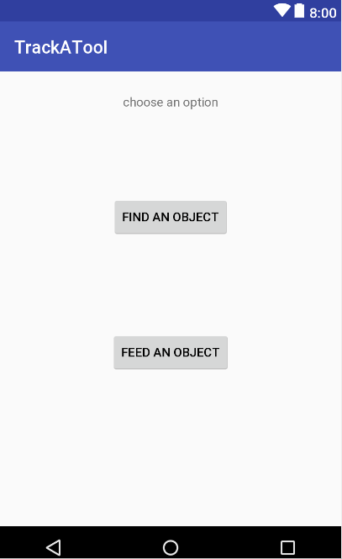
1
UI of our App
Upon opening our app, we can see
1) Find an Object
To find the location of user defined object
2) Feed an Object
To give a new object as input
(defining a new user defined object).

Slide 7
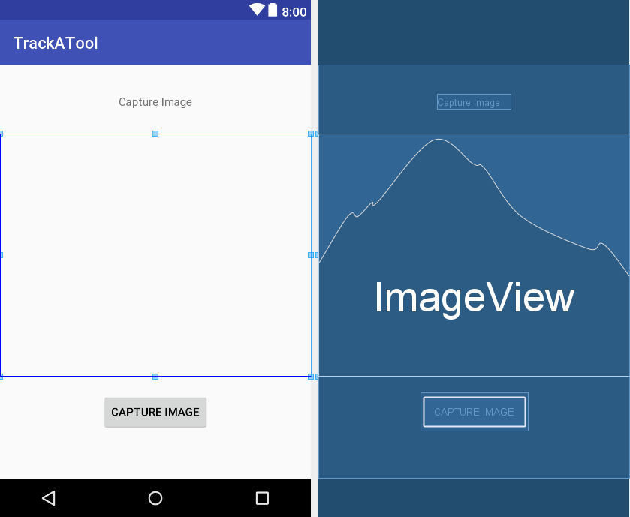
2
Choosing to feed an object, opens up the camera.

Slide 8
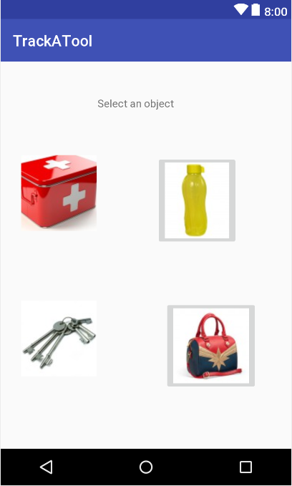
3
Choosing to find an object, app shows all images of user defined object.
Selecting any object shows the location w.r.t ref.object

Slide 9
Software testing and validation

Slide 10
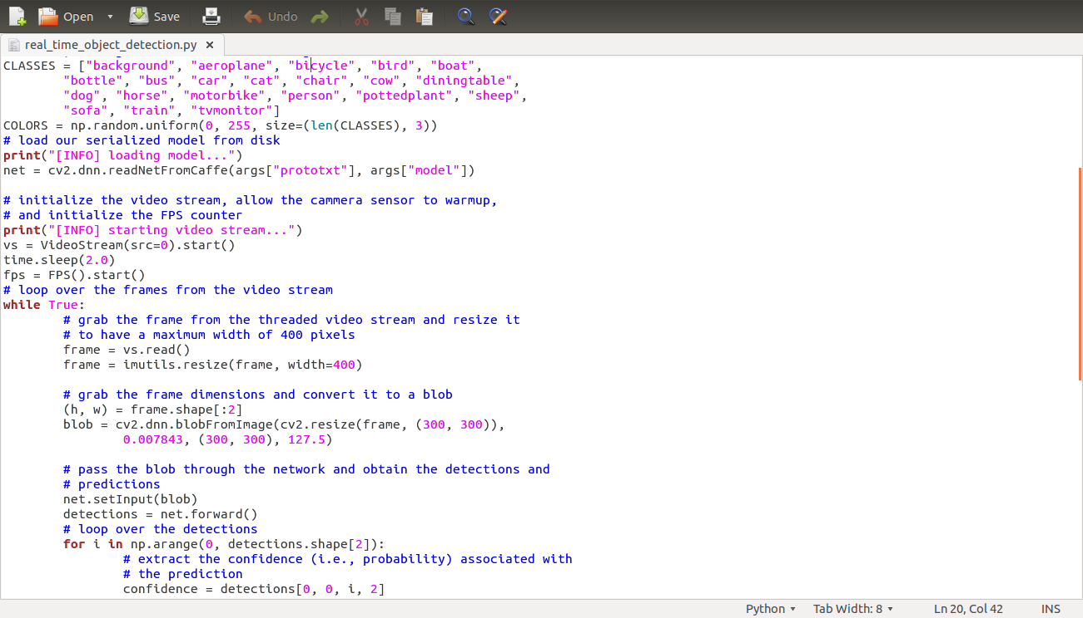

Slide 11
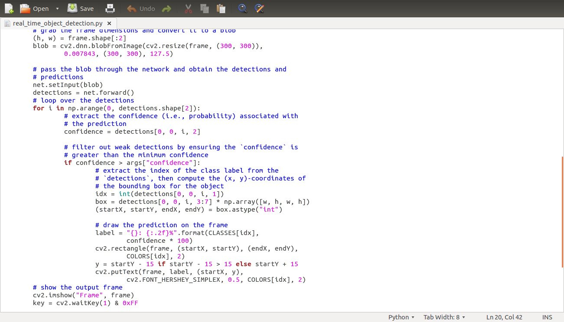

Slide 12
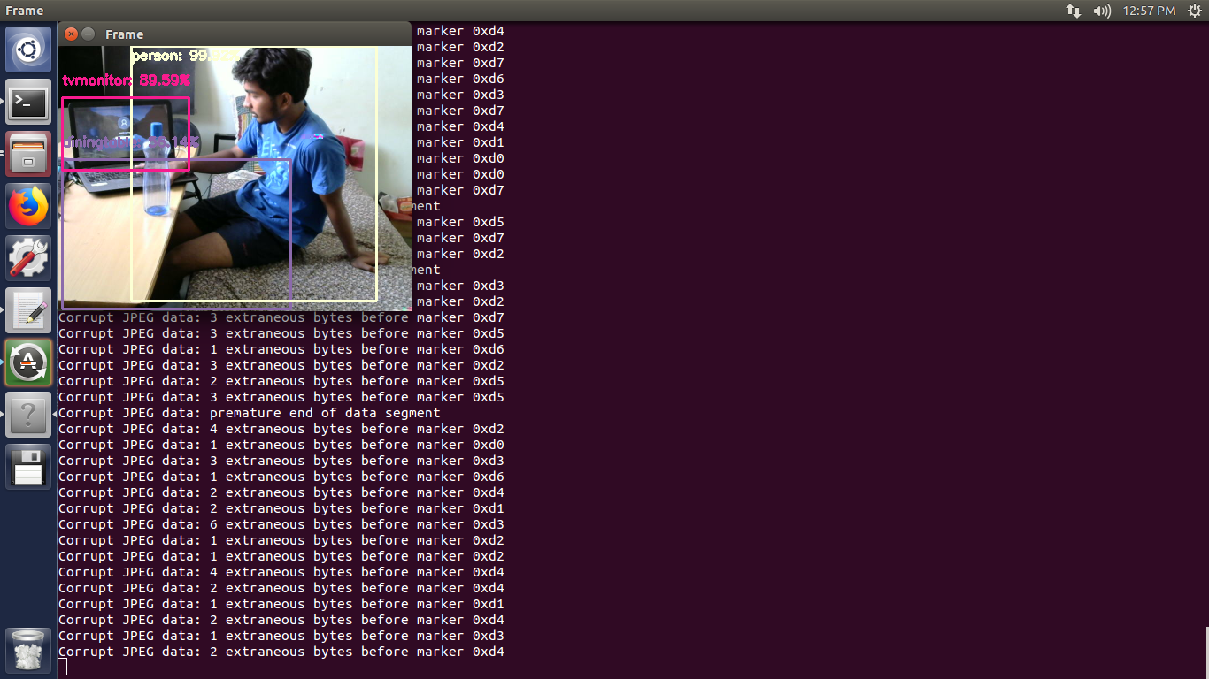
Objects detected are:
Tvmonitor = 89.59%
Person = 99%
Table = 55%

Slide 13
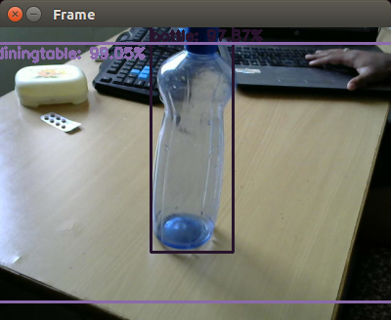
Objects detected from the figure are:
Table = 99.05%
Bottle =97.87%

Slide 14
Hardware implementation
Booting and installing linux in beaglebone black
Installing webcam on Beaglebone black

Slide 15
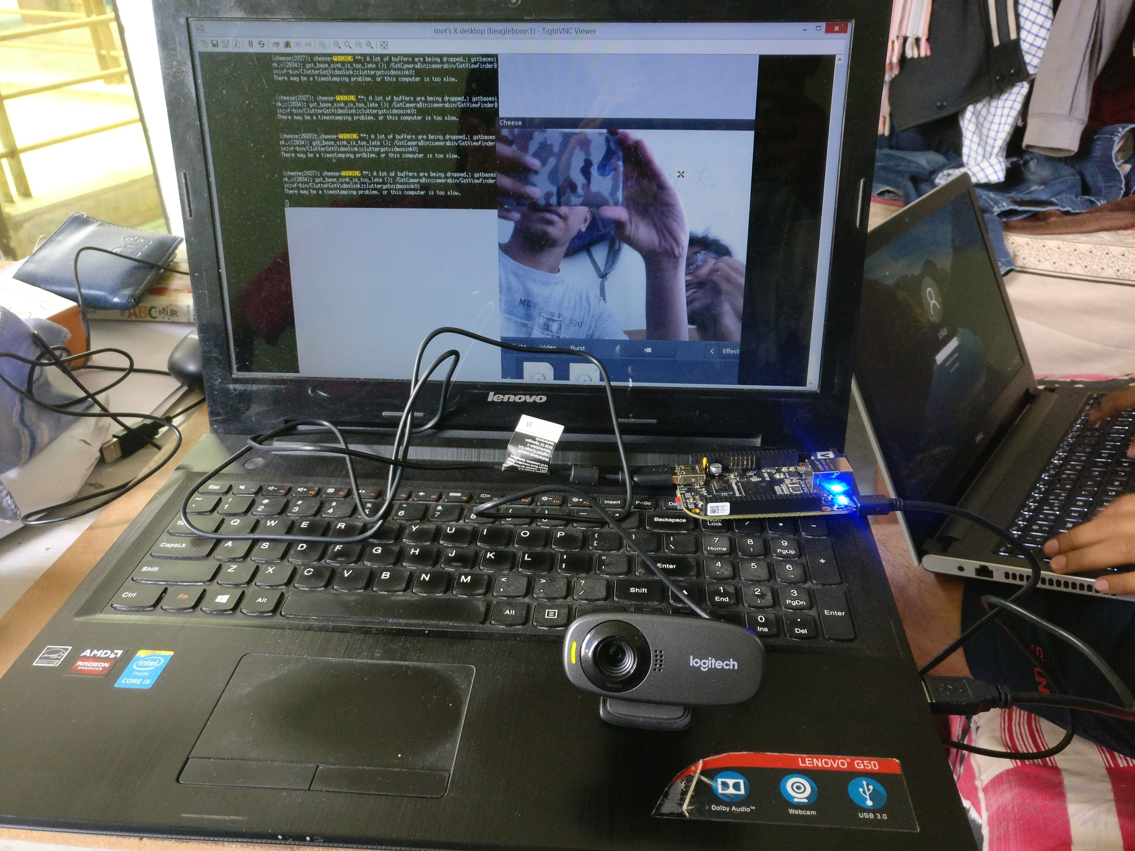

Slide 16
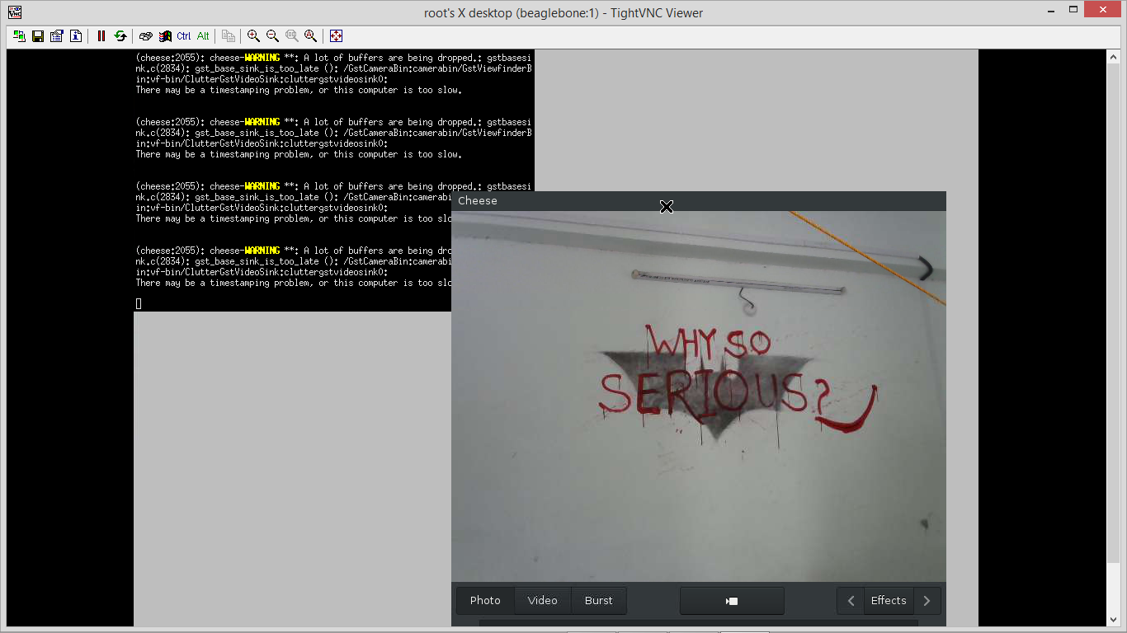

Slide 17
Challenges faced
As many camera modules are not compatible with Beaglebone Black, we are using web cam for our purpose
Expanding Internal memory (4 GB) using external SD card
Creating remote desktop for using Beaglebone Black
Common database for both app and device (not yet sorted).

Slide 18
Thank You

